Slide 1

Learning Objectives:
I can apply all learned concepts from previous lessons.
I can collaborate to solve cybersecurity challenges in a simulated environment.
I can reflect on the importance of cybersecurity in daily life.
Success Criteria:
All: Apply basic cybersecurity knowledge to solve simple challenges collaboratively.
Most: Work together to tackle intermediate cybersecurity problems using prior knowledge.
Some: Analyse and resolve complex cybersecurity issues, demonstrating critical thinking and leadership during the challenge.

Slide 2

Introduction to the Escape Room
The Escape Room today is all about teamwork and applying your cybersecurity knowledge. You’ll be rotating through different stations, each one testing a specific skill like detecting phishing, identifying malware, and securing a network. Remember, teamwork is key – you’ll need to communicate and collaborate effectively to complete the tasks before the time runs out.
The Escape Room Challenge is designed to simulate real-world cybersecurity issues.
Teams must work together to solve challenges and escape within the time limit.
You will rotate through different stations, each one presenting a unique cybersecurity problem.

Slide 3
Escape Room Rules and Objectives
You’ll have 10 minutes at each station to solve the challenge. Your goal is to solve the problem and collect as many points as possible. Make sure everyone in your team is involved and communicates clearly. You’ll have a timer at each station, and once time is up, you’ll rotate to the next station.
Rules:
Work together as a team.
Each station has a time limit of 10 minutes.
Follow the instructions at each station carefully.
Communicate and share information to solve the challenge.
No external help allowed – rely on your team.

Slide 4
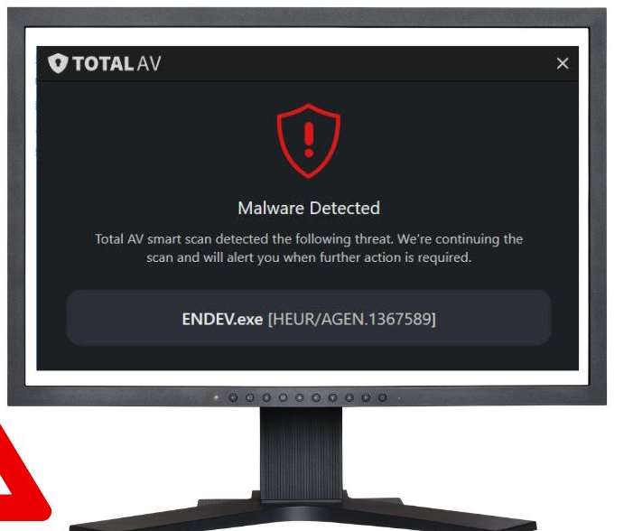

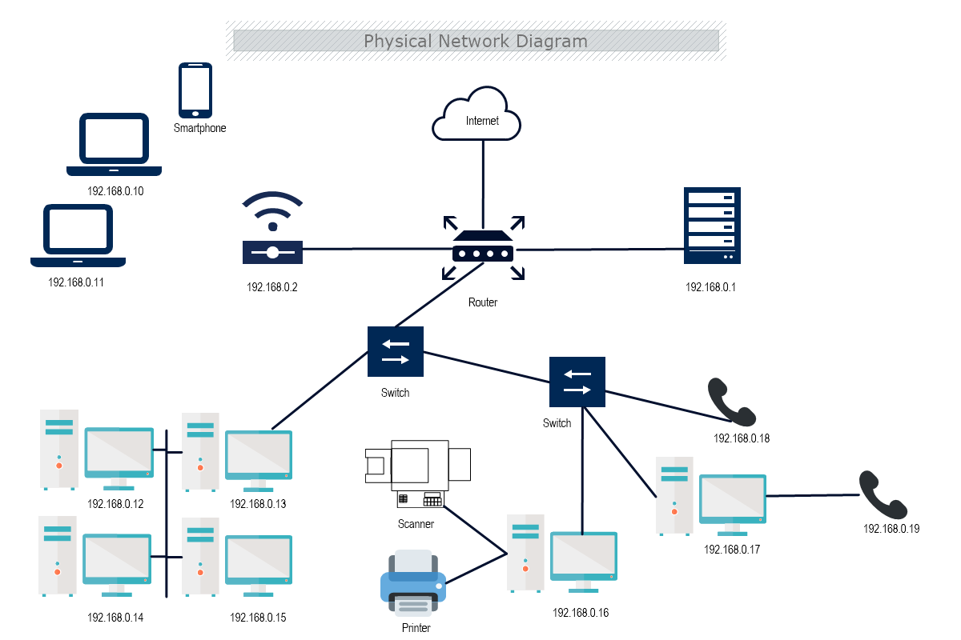

Challenge Stations Overview
Each station will test a different area of cybersecurity. At Station 1, you’ll be looking at files to identify malware. At Station 2, you’ll configure a network to secure it from attacks. At Station 3, you’ll need to detect phishing attempts by examining emails. And at Station 4, you’ll role-play social engineering scenarios and figure out how to respond. Be sure to communicate as a team and work quickly!
Station 1: Identify Malware – Analyse sample files and identify the malware type.
Station 2: Secure a Network – Configure settings to protect a simulated network.
Station 3: Detect Phishing – Review emails to spot phishing attempts.
Station 4: Social Engineering – Role-play responses to common social engineering attacks

Slide 5
Station 1 – Identifying Malware
At this station, your task is to analyse sample files and determine which type of malware they contain. You’ll need to look for unusual file extensions, check file sizes, and pay attention to anything that seems off, like corrupted data or encrypted files.
Analyse the provided files and determine which malware is present.
Clues: Look for unusual file extensions, suspicious file sizes, and any corrupted data.

Slide 6
Station 2 – Securing a Network
At this station, you’ll secure a network. You’ll need to configure firewall settings, adjust user permissions, and ensure antivirus software is installed and running. The goal is to prevent any external threats from accessing your system.
Configure the network settings to protect against potential cyber threats.
Focus Areas: Firewall settings, user permissions, and antivirus software installation.

Slide 7
Station 3 – Detecting Phishing
At this station, you’ll be reviewing emails to detect phishing attempts. Pay close attention to the URLs – are they slightly misspelled? Does the email create a sense of urgency? Check any attachments to see if they look suspicious.
Review the emails provided and identify any phishing attempts.
Clues: Look for misspelled URLs, urgent language, and suspicious attachments.

Slide 8
Station 4 – Social Engineering Scenarios
At this station, you’ll role-play social engineering scenarios. One of you will act as the attacker, while the others respond to the attack. You might deal with a vishing call or a smishing text. Work with your team to decide how to respond effectively.
Work with your team to decide how to handle the attack.
Role-play responses to various social engineering tactics, including vishing and smishing.

Slide 9
Reflection and Debrief
Let’s come together and reflect on the Escape Room Challenge. What strategies worked well for your team? How did you overcome the challenges you faced? Which concepts from previous lessons were the most helpful today?
What strategies worked well for your team?
How did you overcome challenges together?
What concepts from previous lessons were most useful?

Slide 10
Self-Assessment
All: Apply basic cybersecurity knowledge to solve simple challenges collaboratively.
Most: Work together to tackle intermediate cybersecurity problems using prior knowledge.
Some: Analyse and resolve complex cybersecurity issues, demonstrating critical thinking and leadership during the challenge.
On a scale from 1 to 5, how confident are you that you can:
Identify malware?
Secure a network?
Detect phishing?
Respond to social engineering attacks?

